Slide 1
Introduction to Computer Science (371-1-1601)
Lectures by: Dr. Dan Vilenchik & Dr. Zion Siksik
Recitations by: Ariel Cohen, Moshiko Davidian, Assaf Livne, Yair Mazal

Slide 2
Recitation 12 Hash Tables, Floating Point

Slide 3
Todays topics
Hash tables
Fixed/Floating point

Slide 4
Hash Functions - concept
Hash function: a function that maps a large (possible infinite) set to a smaller set of a fixed (yet possibly large) size.
example for a hash function of possibly infinite strings to integers represented by 121 bits.
#example of user defined hash function for strings (not recommended) def hash4strings(st): """ ord(c) is the ascii value of character c 2**120+451 is a prime number """ s = 0 for i in range(len(st)): s = (128*s + ord(st[i])) % (2**120+451) return s**2 % (2**120+451)

Slide 5
Python's built-in hash Function
Python comes with its own hash function, from everything immutable to integers (both negative and positive).
s = 'Tis but a scratch’
y = hash(s) print(y) print(bin(y))

Slide 6
Python's built-in hash Function – Cont’d
However it cannot hash mutable objects, which is why for instance dictionary keys cannot be lists
ls = [4, 3] # Will this work? hash(ls)
# Will this work? dic = {ls: 1, 'a': 2}

Slide 7

Python's built-in hash Function – Cont’d
Our use of hash function would be to store items in a lookup table.
However, The range of Python's hash function is too large for practical sizes of tables, and it contains negative values.
We can thus reduce the range to a set of m elements by:
m = 1000 z = hash(s) % m print(z) print(bin(z))

Slide 8
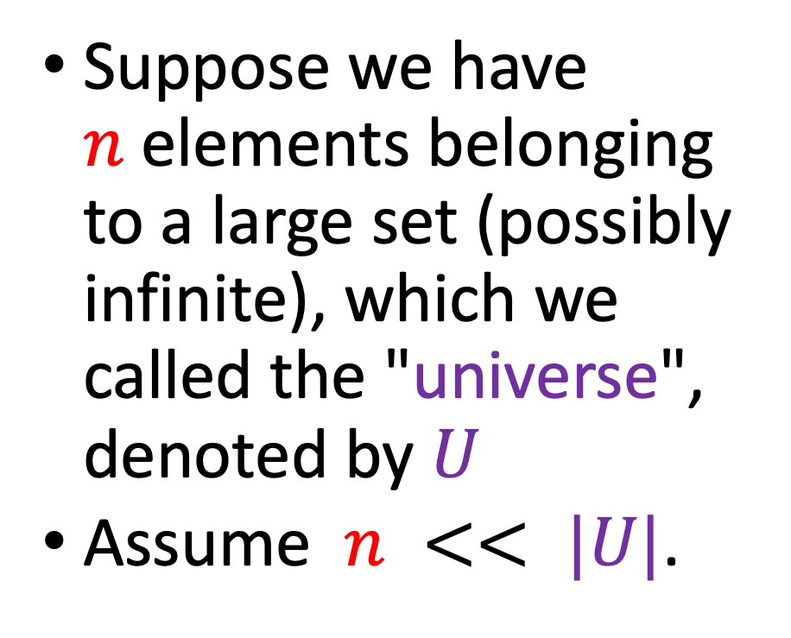
Hash Tables – Concept #1
Suppose we have $n$elements belonging to a large set (possibly infinite), which we called the "universe", denoted by $U$
Assume $n << |U|$.
U
T
x=“ATTA…”
x
z
y
w
0
1
2
3
4
5
6
h(x)=1
y=“GGCT…”
z=“GCTT…”
h(z)=3
h(y)=5
w=“CCCC…”
h(w)=6
m=7

Slide 9
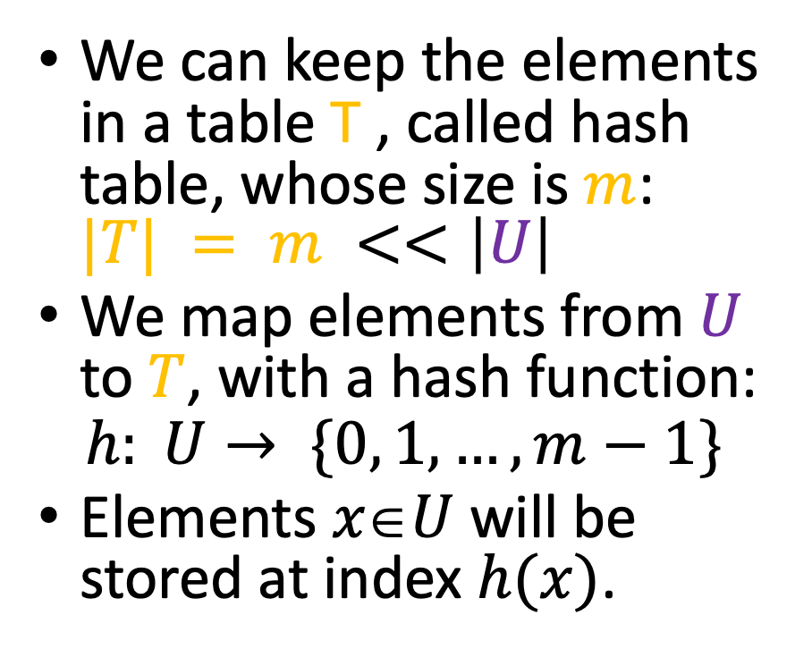
Hash Tables – Concept #2
We can keep the elements in a table T , called hash table, whose size is $m$: $|T| = m <<\left|U\right|$
We map elements from $U$ to $T$, with a hash function:
$$h: U→ \{0, 1, …, m−1\}$$
Elements $xU$ will be stored at index $h(x)$.
U
T
x=“ATTA…”
x
z
y
w
0
1
2
3
4
5
6
h(x)=1
y=“GGCT…”
z=“GCTT…”
h(z)=3
h(y)=5
w=“CCCC…”
h(w)=6
m=7

Slide 10
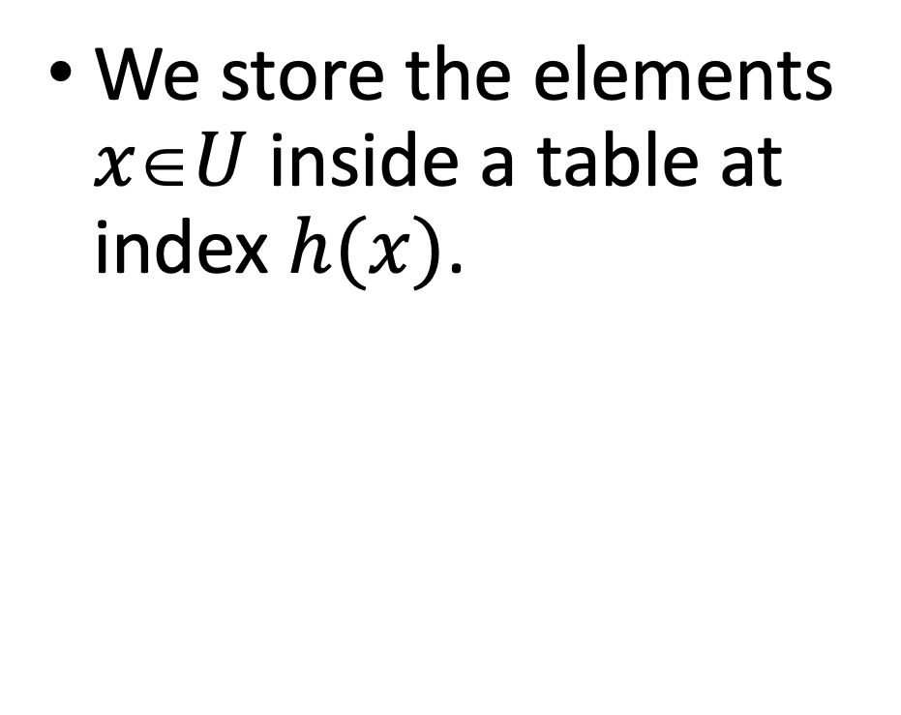
Hash Tables – Concept #3
We store the elements $xU$ inside a table at index $h(x)$.
U
T
x=“ATTA…”
x
z
y
w
0
1
2
3
4
5
6
h(x)=1
y=“GGCT…”
z=“GCTT…”
h(z)=3
h(y)=5
w=“CCCC…”
h(w)=6
m=7

Slide 11
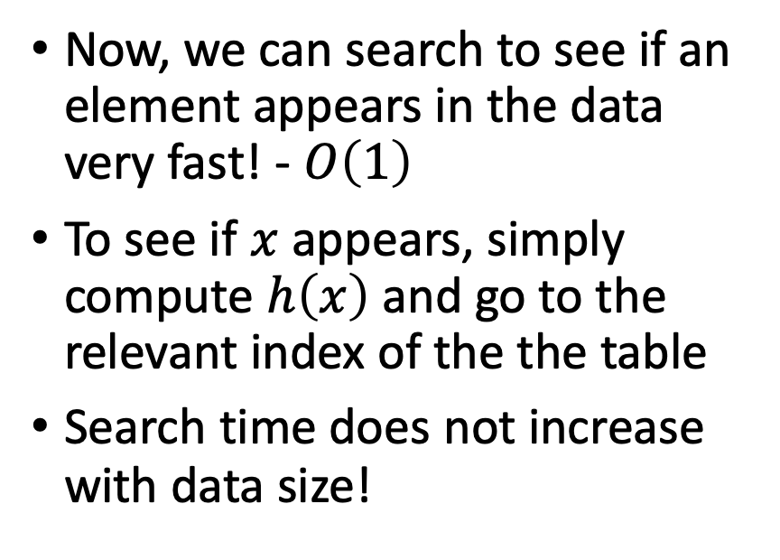
Hash Tables – Concept #4
What did we gain?
What did we sacrifice?
Now, we can search to see if an element appears in the data very fast! - $O\left(1\right)$
To see if $x$ appears, simply compute $h\left(x\right)$ and go to the relevant index of the the table
Search time does not increase with data size!
We need to find a good hash function and build the table.
Other issues may complicate implementation, and reduce performance – next slides

Slide 12
Collisions
Since we map a large group to a smaller one, multiple values will hold the same hash key.
Can be addressed via:
Chaining – putting multiple elements in the same index, but then requires to search within table cell between all elements to see of item exists
how would you solve it?

Slide 13
Collision handling - Linear Probing
If slot h(x) % k is full, then we try (h(x) + 1) % k
If slot (h(x) + 1) % k is full, then we try (h(x) + 2) % k
If slot (h(x) + 2) % k is full, then we try (h(x) + 3) % k
And so on…
What may happen if we’ll have many collisions?
Clustering

Slide 14
Collision handling - Quadratic Probing
If slot h(x) % m is full, then we try (h(x) + 1*1) % m
If (h(x) + 1*1) % m is also full, then we try (h(x) + 2*2) % m
If (h(x) + 2*2) % m is also full, then we try (h(x) + 3*3) % m
And so on…

Slide 15
Collision handling - Double Hashing
If slot h(x) % m is full, then we try (h(x) + 1*h2(x)) % m
If (h(x) + 1*h2(x)) % m is also full, then we try (h(x) + 2*h2(x)) % m
If (h(x) + 2*h2(x)) % m is also full, then we try (h(x) + 3*h2(x)) % m
And so on…
What's the pros and cons of this kind of handling?

Slide 16
Creating a Hashtable Class
Constructor takes a hash function, and table size as arguments
Insert method adds items to table. To deal with possible collisions we chain them, i.e. each table element is a standard list of item with same keys.
Find method returns true if item is in table and false otherwise.
class Hashtable: def __init__(self, m, hash_func=hash): """ initial hash table, m empty entries, uses hash_func """ self.table = [[] for i in range(m)] self.hash_mod = lambda key: hash_func(key) % m def __repr__(self): L = [self.table[i] for i in range(len(self.table))] return "".join([str(i) + " " + str(L[i]) + "\n" for i in range(len(self.table))]) def find(self, item): """ returns True if item in hashtable, False otherwise """ i = self.hash_mod(item) chain = self.table[i] return item in chain # a hidden loop def insert(self, item): """ insert an item into table, if not there """ i = self.hash_mod(item) chain = self.table[i] if item not in self.table[i]: # a hidden loop self.table[i].append(item)

Slide 17
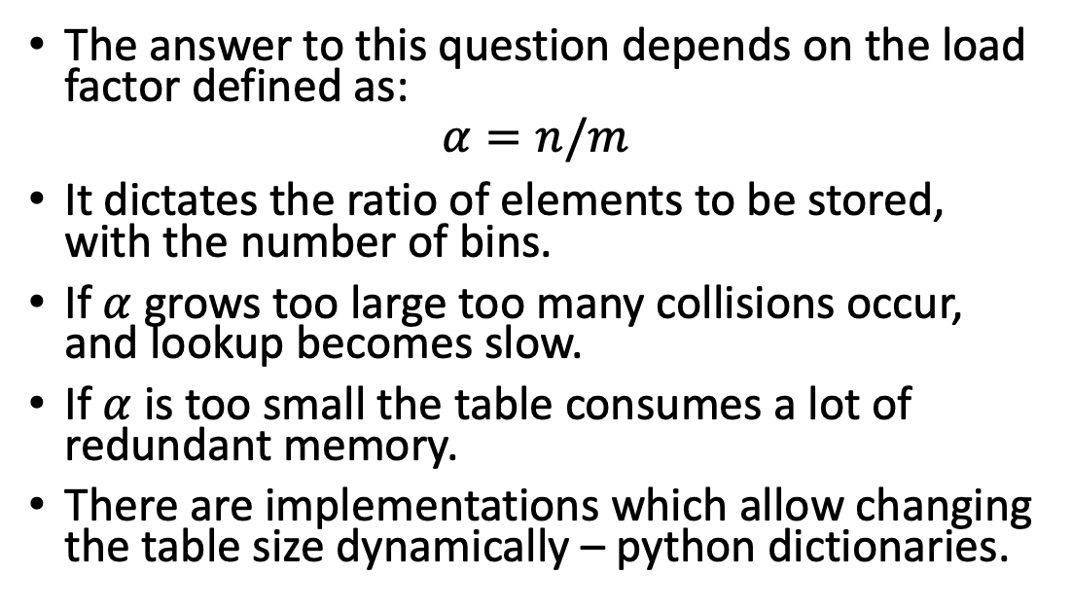
Efficiency Aspects
Hash functions
Optimal table size
We need to choose functions which allow:
Fast computation
distribute values uniformly – to minimize risk of collision
The answer to this question depends on the load factor defined as:
$$α=n/m$$
It dictates the ratio of elements to be stored, with the number of bins.
If $α$ grows too large too many collisions occur, and lookup becomes slow.
If $α$ is too small the table consumes a lot of redundant memory.
There are implementations which allow changing the table size dynamically – python dictionaries.

Slide 18
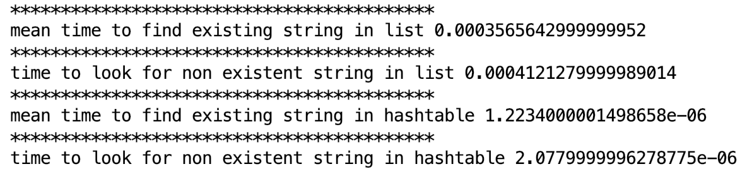
Hashtable performance
We create a list of 10000 strings
Each string has a random length between 10-3000 symbols
We then do lookups for existing and non-existing elements on the:
original list
on a hashed version

Slide 19
Open addressing
Open addressing allows collision handling without the need of increasing memory allocation of the hash table
How would you find if hash table stores value v?
How would find or delete methods needs to be implemented ?

Slide 20
Hashing User Defined Classes
By default python uses the memory address of an object as an argument for the hash function.
If one wishes to change this behavior use the __hash__ () function.
Do we need the __eq__() method?
class Animal: def __init__(self, _species, _id, _name): self.species = _species self.id = _id self.name = _name def __hash__(self): # so we can use hash() on a Animal return hash(self.id) # assume id is a unique identifier def __eq__(self, other): # so we can search for students in the table return self.id == other.id and \ self.species == other.species and \ self.name == other.name

Slide 21
Hashing User Defined Classes – Cont’d
What is the hash table size?
How many Animals (at least) share the same hash key
Is there a way to know exactly how many?
if __name__ == '__main__': hash_t = Hashtable(6) # dogs for i in range(3): hash_t.insert(Animal(AninmalSpecies.dog, i, 'woofer')) # cats for i in range(3, 6): hash_t.insert(Animal(AninmalSpecies.cat, i, 'Garfield')) # horses for i in range(6, 9): hash_t.insert(Animal(AninmalSpecies.horse, i, 'Bucephalus')) # Do you know who was Bucephalus? print(hash_t.find(Animal(AninmalSpecies.horse, 8, 'Seabiscuit'))) print(hash_t.find(Animal(AninmalSpecies.horse, 8, 'Bucephalus')))

Slide 22
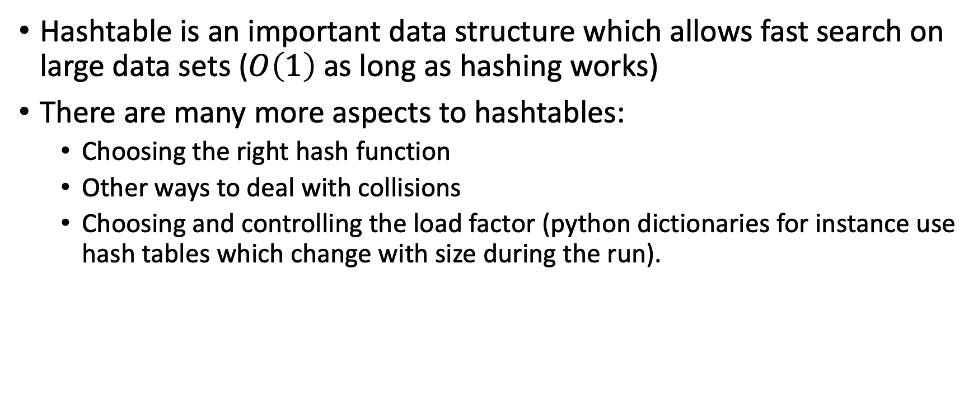
Hashtable Summary
Hashtable is an important data structure which allows fast search on large data sets ($O\left(1\right)$ as long as hashing works)
There are many more aspects to hashtables:
Choosing the right hash function
Other ways to deal with collisions
Choosing and controlling the load factor (python dictionaries for instance use hash tables which change with size during the run).

Slide 23
Floating Point

Slide 24
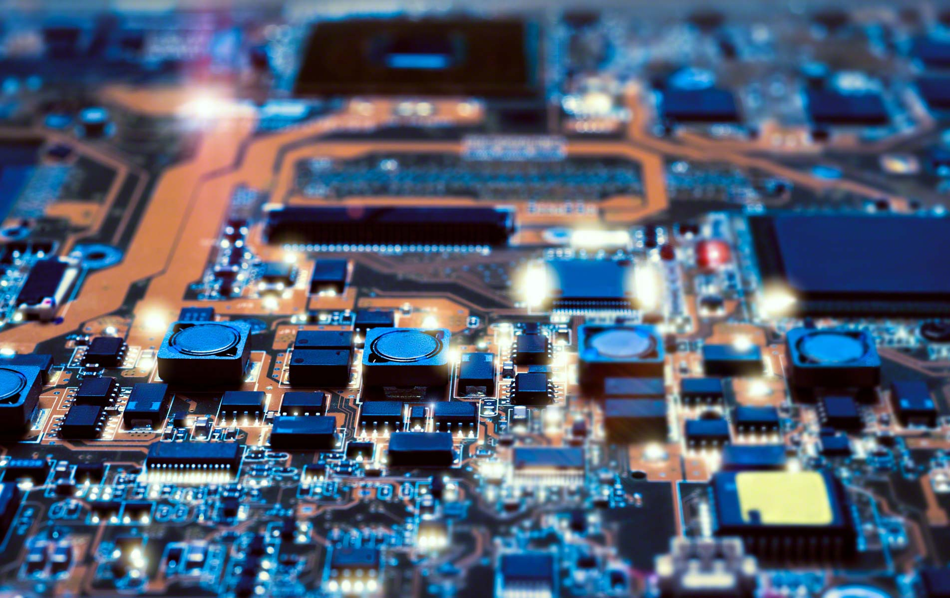
THE PROBLEM
The trouble with representing real numbers is that there are an awful lot of them.
There an infinitely many different numbers between any given two numbers.
Computers don’t have the ability to store and manipulate infinite different values. Computers have hard software boundaries (RAM, Disk, registers)

Slide 25

The wonders of real numbers
we need to dive in and understand how real numbers (infinite values) represents in a world of finite values (computer’s memory)
To store a real value in a predefined memory allocation we may use several techniques
print(0.1 + 0.1 == 0.2) print(0.1 + 0.1 + 0.1) print(0.1 + 0.1 + 0.1 == 0.3)

Slide 26
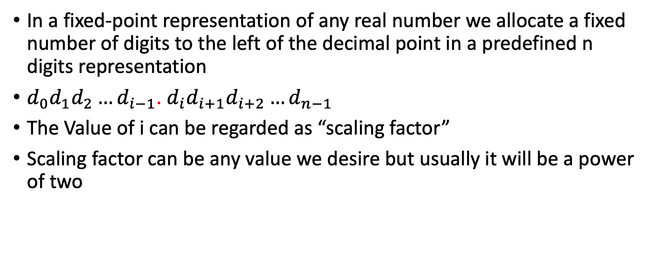
Fixed point
In a fixed-point representation of any real number we allocate a fixed number of digits to the left of the decimal point in a predefined n digits representation
$d_{0}d_{1}d_{2}…d_{i−1}$. $d_{i}d_{i+1}d_{i+2}…d_{n−1}$
The Value of i can be regarded as “scaling factor”
Scaling factor can be any value we desire but usually it will be a power of two

Slide 27
Fixed point
Assume 8-bit pattern: 01110110
With a scaling factor of 1/16: 0111.0110 is 7.375
With a scaling factor of 1/4: 011101.10 is 29.5
With a scaling factor of 1/64: 01.110110 is 1.84375
Scaling factor which is not a power of 2 will make calculations slower.

Slide 28
Fixed point
Bounds numbers to a fixed order of magnitude and precision.
A need to a different scaling factor for different calculations
Frequent rounding due to arithmetical operations may cause loss of precision
Hardware implementation

Slide 29
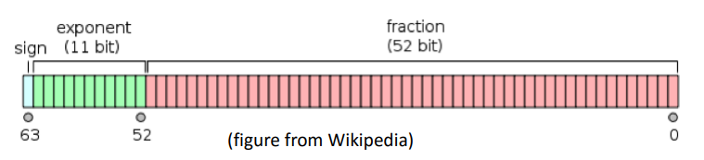
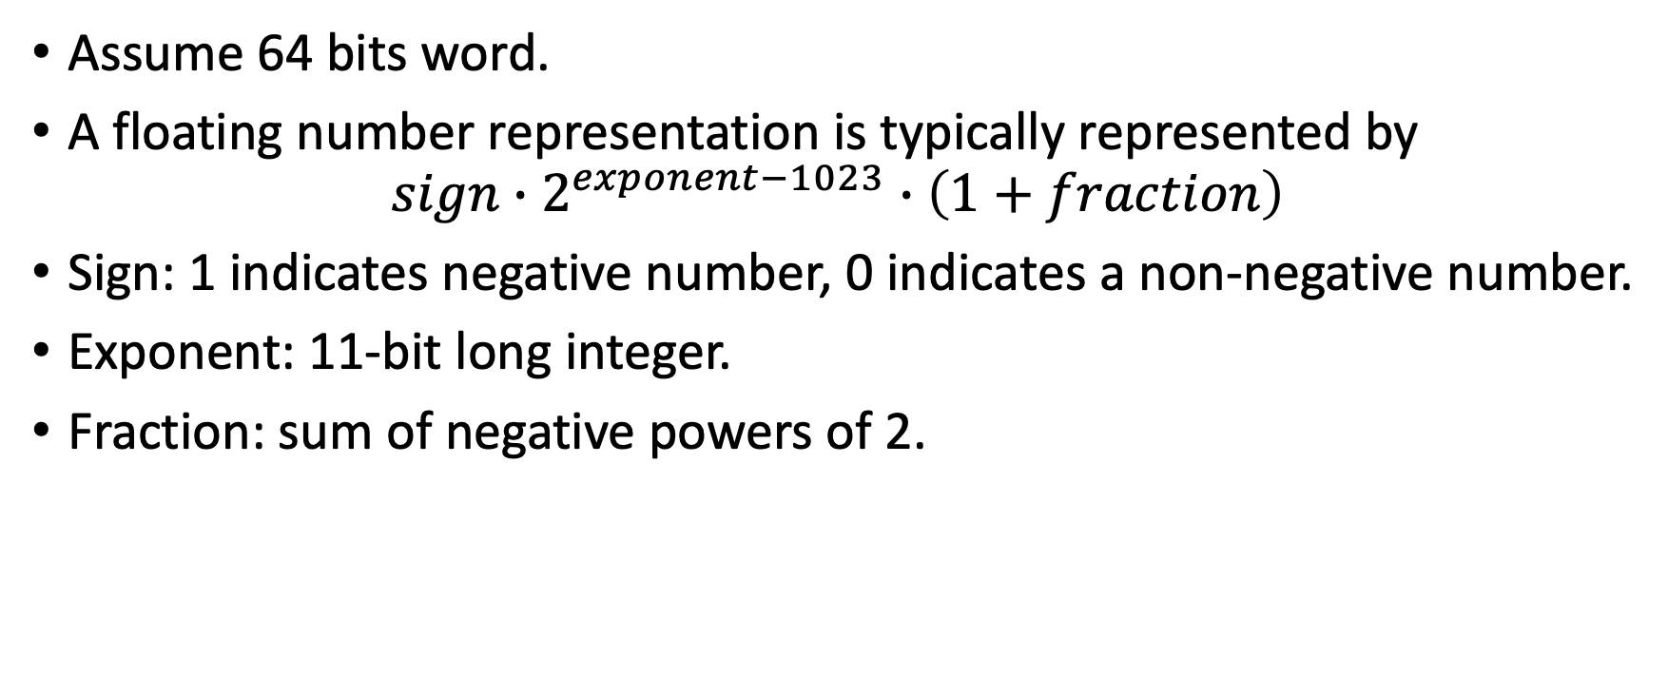
Floating point
Assume 64 bits word.
A floating number representation is typically represented by
$$sign∙2^{exponent−1023}∙\left(1+fraction\right)$$
Sign: 1 indicates negative number, 0 indicates a non-negative number.
Exponent: 11-bit long integer.
Fraction: sum of negative powers of 2.

Slide 30
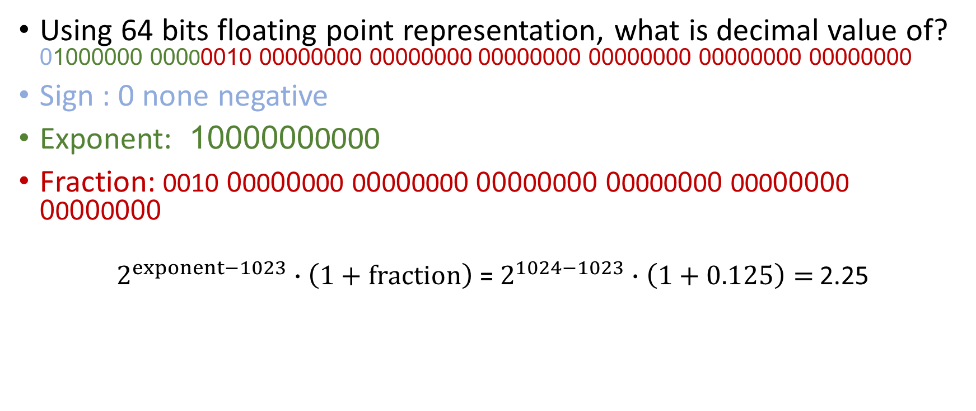
Floating point example
Using 64 bits floating point representation, what is decimal value of? 01000000 00000010 00000000 00000000 00000000 00000000 00000000 00000000
Sign : 0 none negative
Exponent: 10000000000
Fraction: 0010 00000000 00000000 00000000 00000000 00000000 00000000
$2^{exponent−1023}∙\left(1+fraction\right)$ = $2^{1024−1023}∙\left(1+0.125\right)=$2.25

Slide 31
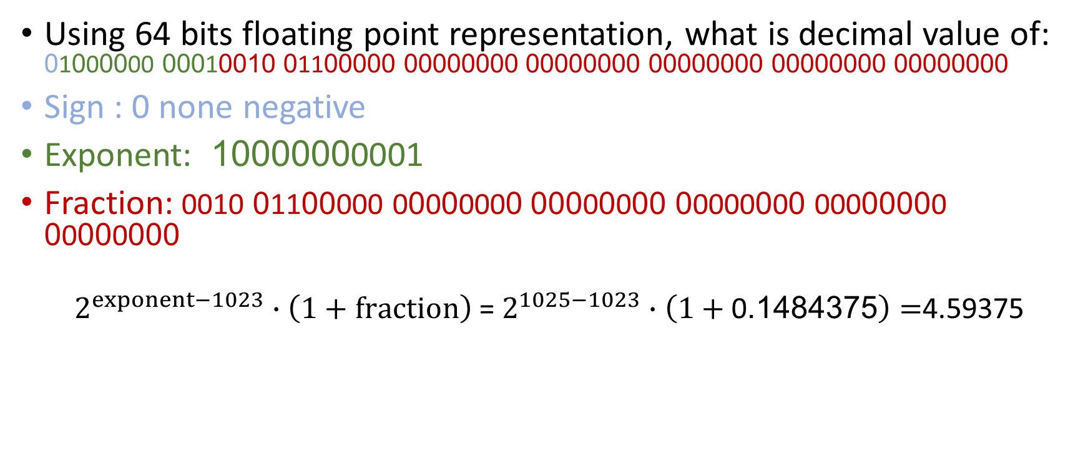
Floating point example
Using 64 bits floating point representation, what is decimal value of: 01000000 00010010 01100000 00000000 00000000 00000000 00000000 00000000
Sign : 0 none negative
Exponent: 10000000001
Fraction: 0010 01100000 00000000 00000000 00000000 00000000 00000000
$2^{exponent−1023}∙\left(1+fraction\right)$ = $2^{1025−1023}∙\left(1+\text{0}\text{.1484375}\right)=$4.59375

Slide 32
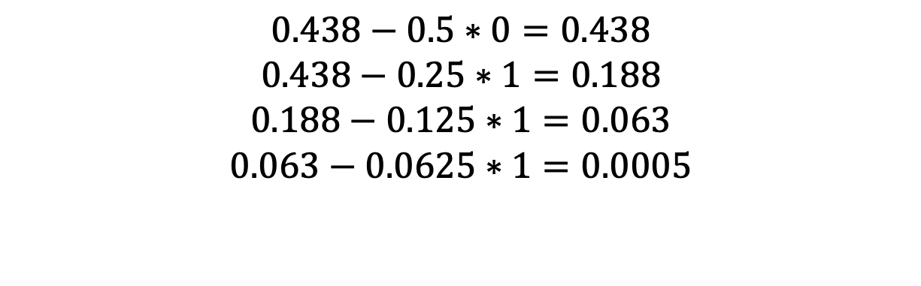
Decimal fraction to binary – example
Converting 0.438 binary representation:
$$0.438−0.5∗0=0.438$$
$$0.438−0.25∗1=0.188$$
$$0.188−0.125∗1=0.063$$
$$0.063−0.0625∗1=0.0005$$

Slide 33
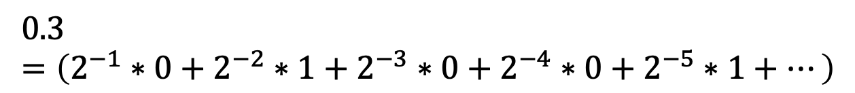
Decimal to floating point
Converting 23.3 to 64 bits floating point representation
converting 23 to its binary value: 10111
Then we’ll have to construct 0.3 binary value. We will do that by series of multiplications until zeroing the right side of the decimal point or finding a repeating pattern. 0.3 * 2 = 0.6 0 0.6 * 2 = 1.2 1 0.2 * 2 = 0.4 0 0.4 * 2 = 0.8 0 0.8 * 2 = 1.6 1 0.6 * 2 = 1.2 1
$${23.3 }_{10}={10111.0100110011…0011}_{2}$$
$$0.3=\left(2^{−1}∗0+2^{−2}∗1+2^{−3}∗0+2^{−4}∗0+2^{−5}∗1+…\right)$$

Slide 34
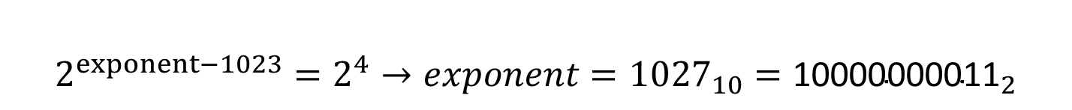

Decimal to floating point
Setting the Exponent value is done by shifting the decimal point leftwards till it resides right of the leading 1
In our example we shift the decimal point 4 steps, so in order to normal it back we will need to multiply our number by $2^{4}$, so :
$${10111.0100110011…0011}_{2}$$
$${1.01110100110011…0011}_{2}$$
$$2^{exponent−1023}=2^{4}→exponent={1027}_{10}={\text{10000000011}}_{2}$$
0
1 | 0 | 0 | 0 | 0 | 0 | 0 | 0 | 0 | 1 | 1
0 | 1 | 1 | 1 | 0 | 1 | 0 | 0 | 1 | 1
…
0 | 0 | 1 | 1
sign
exponent
fraction

Slide 35
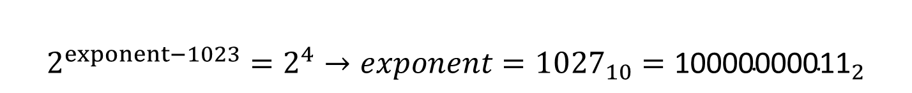
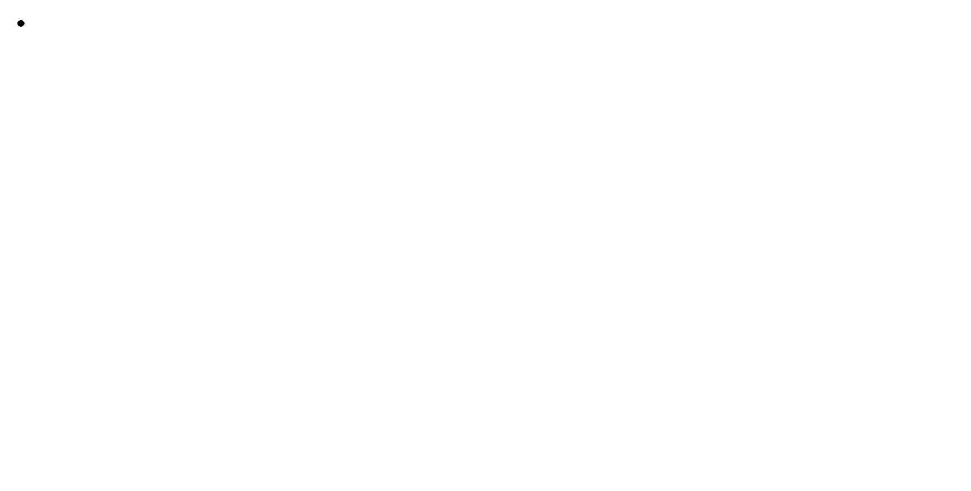
Decimal to floating point
$${1.011101001110011…10011}_{2}$$
$$2^{exponent−1023}=2^{4}→exponent={1027}_{10}={\text{10000000011}}_{2}$$
0
1 | 0 | 0 | 0 | 0 | 0 | 0 | 0 | 0 | 1 | 1
0 | 1 | 1 | 1 | 0 | 1 | 0 | 0 | 1 | 1
…
0 | 0 | 1 | 1
sign
exponent
fraction

Slide 36
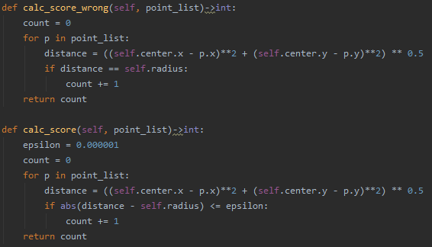

Floating point
Now that we understand how real numbers stored in a limited pre-defined memory allocation, we’re forced to engage real number calculation with care
Following example shows that ~1% of the coordinates on the circle contour are not detected as such.
Solving it is done by allowing some flexibility with the given result

